Slide 1


Project-1
International Medical
Assistance Platform
Empowering and Centralizing Medical Tourism

Slide 2
Problem Statement:
Travel healthcare is a rapidly growing sector in India. Each year, approximately 2 million international patients from over 78 countries visit India for medical, wellness, and IVF treatments. India receives a significant number of patients from African countries such as Mozambique, Tanzania, Zimbabwe, and South Africa.
Despite these advantages, cross-border healthcare access remains complex and inefficient due to dependence on unreliable intermediaries, resulting in delays, misinformation, and lack of transparency.
The aim of this project is to develop a centralized digital platform that brings together all nominated hospitals in India into a single system. This platform will make the medical travel process more efficient, secure, reliable, and transparent for international patients.
International Medical Assistance

Slide 3


Background:
Motivation
India is a global medical tourism hub with advanced healthcare services and affordable treatment costs.
Patients from African countries travel to India for specialized and advanced medical care.
Current systems rely on intermediaries, causing delays, misinformation, and lack of transparency.
This project is motivated by the need to create a secure, centralized, and transparent digital platform that enables direct communication between patients and verified healthcare providers, improving safety, efficiency, and overall patient experience.
International Medical Assistance

Slide 4
Project Aim:
To develop a centralized digital platform that connects international patients directly with nominated Indian hospitals, empowering medical tourism by eliminating unreliable intermediaries and reducing stress caused by lack of transparency and inefficiency.
Objectives:
To centralize verified Indian hospitals and medical services into a single platform.
To eliminate intermediaries, ensuring transparent and trustworthy communication.
To enhance security, efficiency, and reliability in the medical travel process.
To support effective visa application management and reduce the risk of e-visa rejection through accurate documentation and guidance.
International Medical Assistance

Slide 5
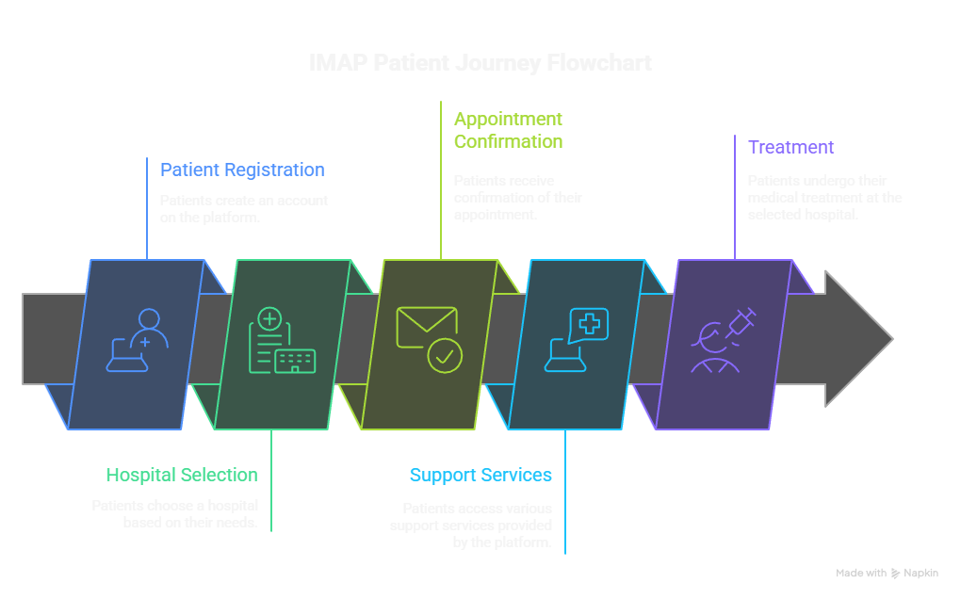
System Overview:
A web-based medical assistance platform designed for international patients seeking treatment in India.
Enables direct connection between patients and verified Indian hospitals and doctors, based on medical needs and specialization.
Eliminates intermediaries, ensuring transparent communication, accurate information, and reduced processing time.
Provides a centralized system for hospital discovery, appointment requests, and medical travel support.
International Medical Assistance

Slide 6
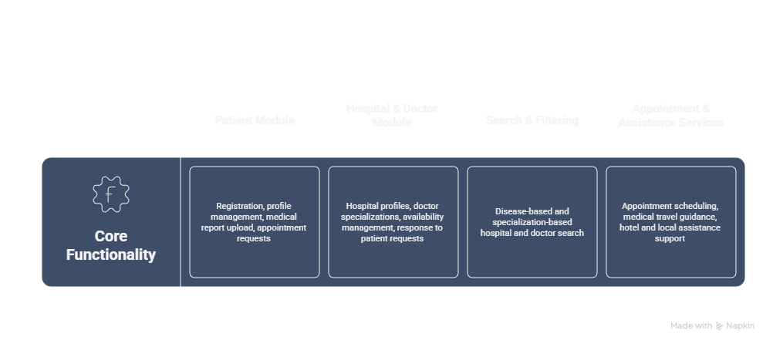
Key Features:
Patient Module - Registration, profile management, medical report upload, appointment requests.
Hospital & Doctor Module - Hospital profiles, doctor specializations, availability management, response to patient requests.
Search & Filtering - Disease-based and specialization-based hospital and doctor search.
Appointment & Assistance Services - Appointment scheduling, medical travel guidance, hotel and local assistance support.
International Medical Assistance

Slide 7
Key Features:
Patient Module - Registration, profile management, medical report upload, appointment requests.
Hospital & Doctor Module - Hospital profiles, doctor specializations, availability management, response to patient requests.
Search & Filtering - Disease-based and specialization-based hospital and doctor search.
Appointment & Assistance Services - Appointment scheduling, medical travel guidance, hotel and local assistance support.
International Medical Assistance

